Slide 1
SPORTS & THE COLD WAR
Victoria Harms
October 8, 2015
HIST 1653 Fall 2015
Notes:
https://www.youtube.com/watch?v=bwJJkeOTT6Y

Slide 2
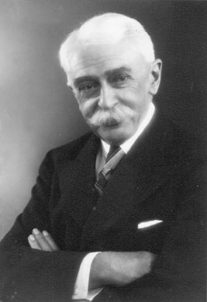
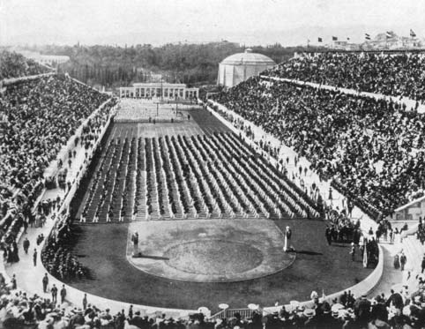
Modern Olympic Games
Pierre de Coubertin (1863-1937)
Notes:
Amateurism –
Why Germany?
Focus on the US. And Germany – Why?

Slide 3
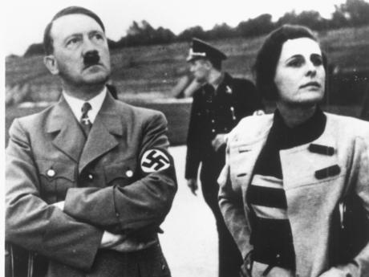

Slide 4
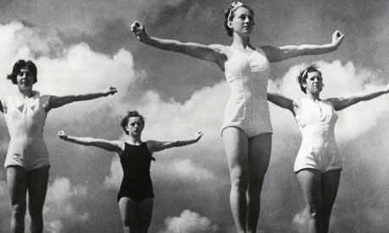
Leni Riefenstahl, Olympia (1936)

Slide 5
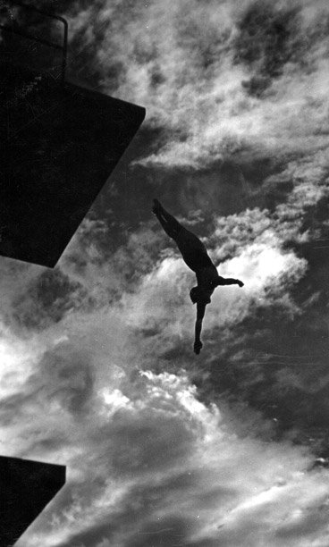
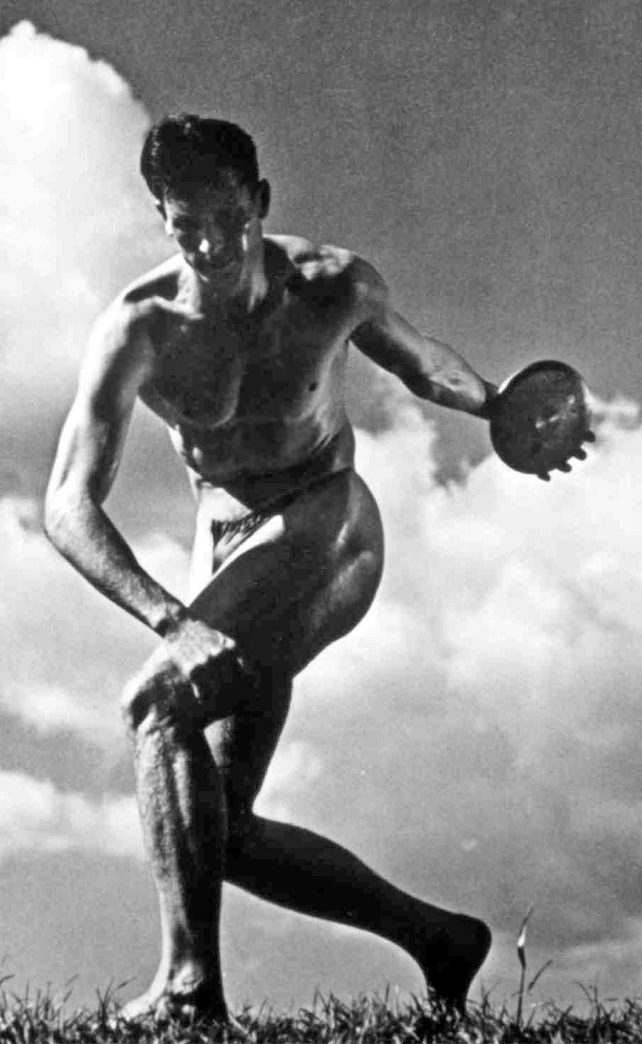
Notes:
1940 Tokyo – cancelled – awarded to Helsinki but then cancelled altogether
Helsinki then in 1952 and Tokyo in 1964

Slide 6
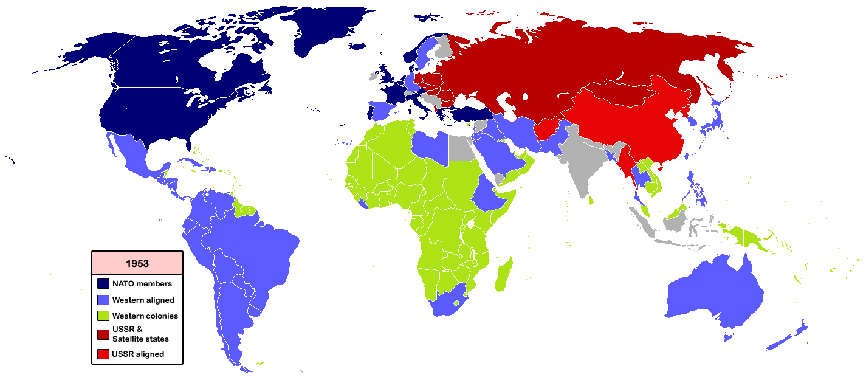
Notes:
Sputnik crisis, 1957
One could easily argue that it was Stalin’s turn around in 1951, his decision to join the Olympic Committee, that has created the Olympic Games as we know them today.

Slide 7
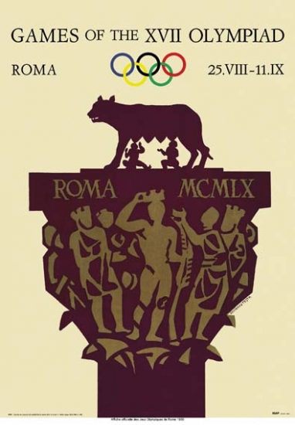
Rome, 1960

Slide 8
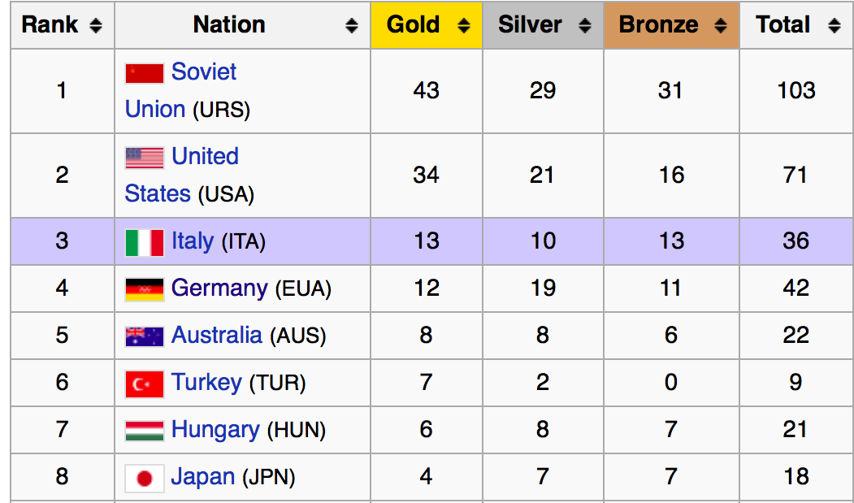
Rome 1960

Slide 9
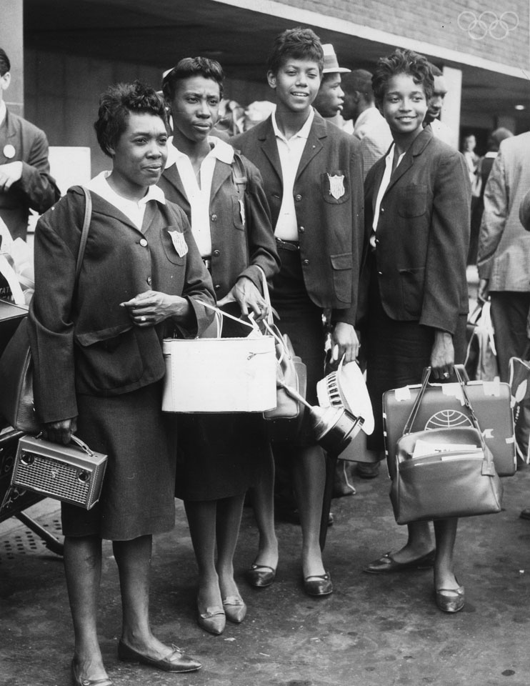
Rome 1960
Notes:
“La Gazzella Nagra” (The Black Gazelle) by the Italians and “La Perle Noire” (The Black Pearl) by the French.
Wilma Rudolph, Lucinda Williams, Barbara Jones and Martha Hudson

Slide 10
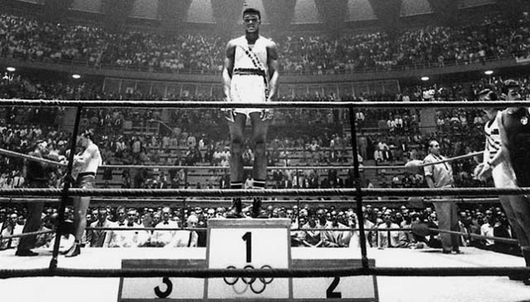

Slide 11
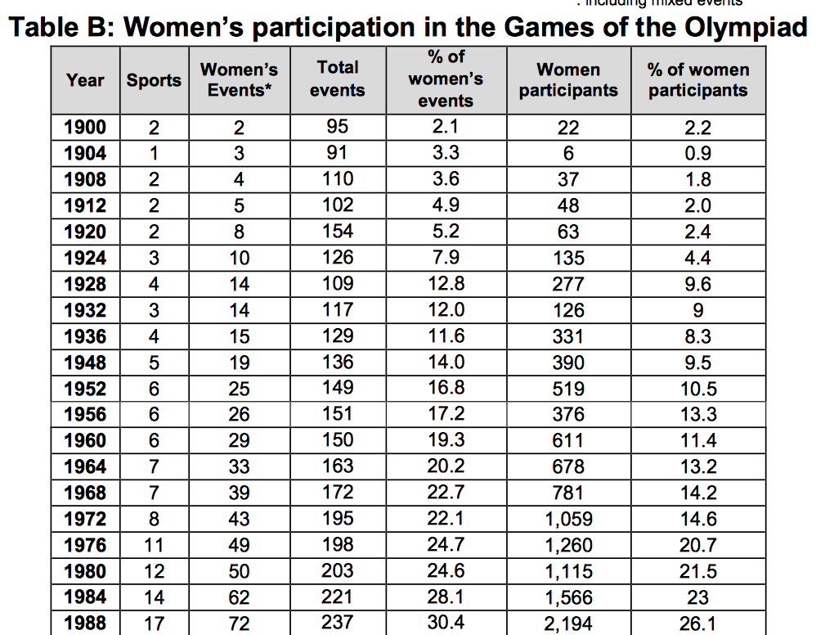
Notes:
In 1968, of the 5,500 participants, less than 800 were women

Slide 12
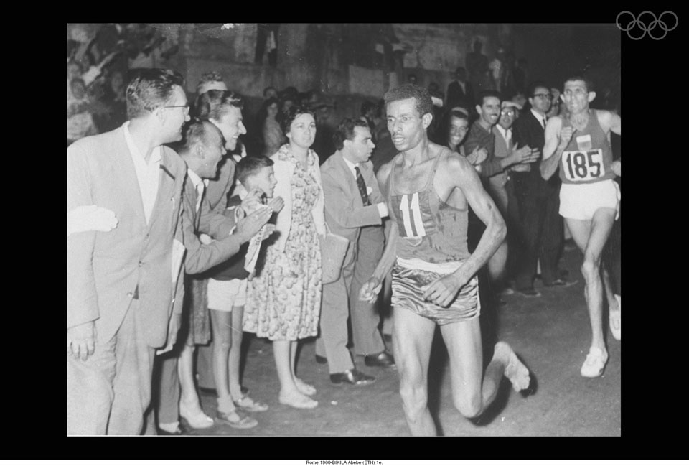

Slide 13
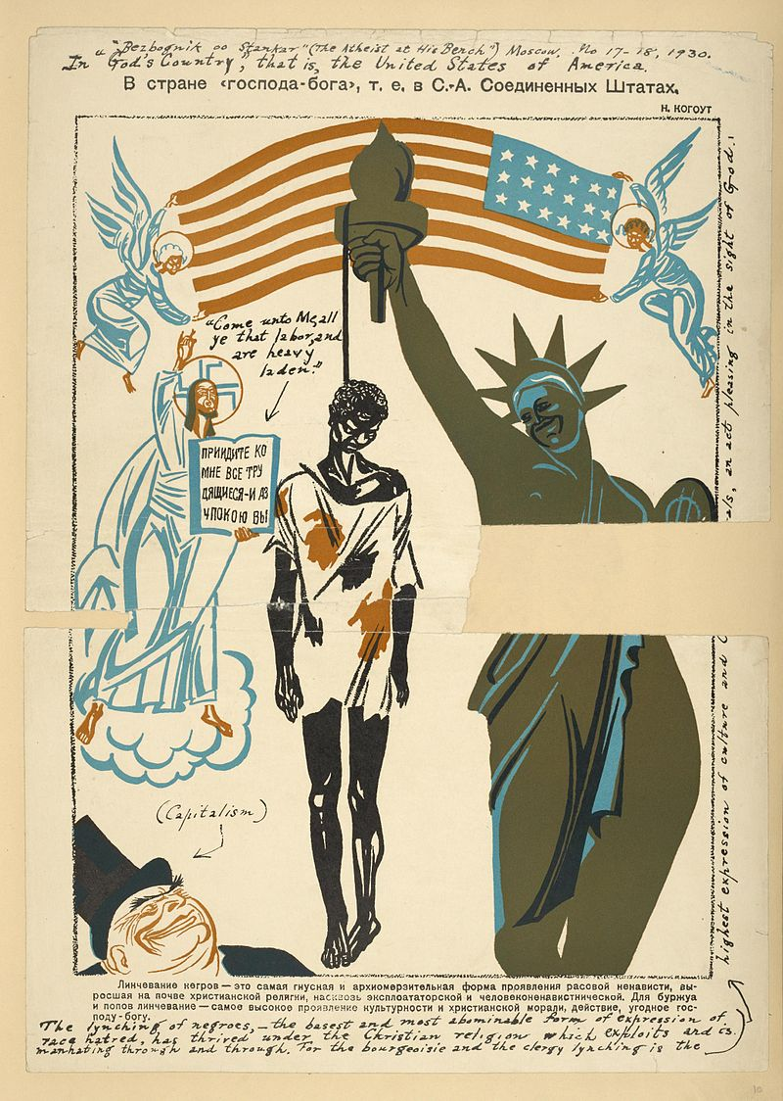

Slide 14
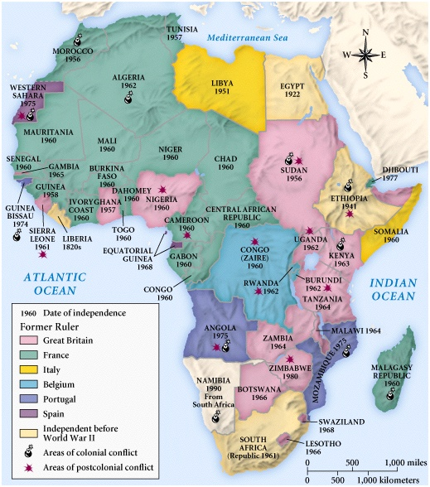

Slide 15
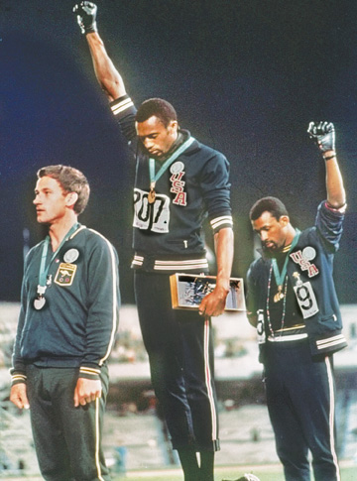
Notes:
Breach of principle -- No objections to Nazi salute in 1936

Slide 16
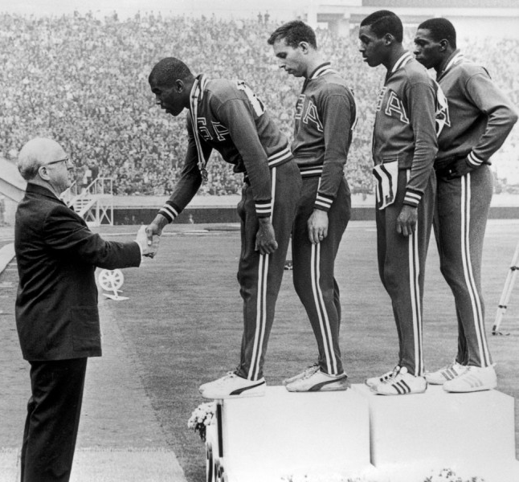
Avery Brundage

Slide 17
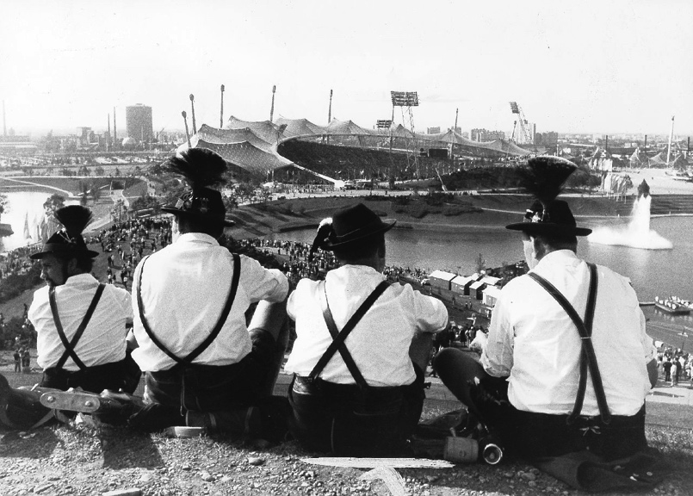
Munich 1972

Slide 18
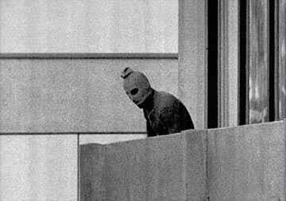
Munich Massacre
Notes:
t the end of August 1967, Arab leaders met in Khartoum in response to the war, to discuss the Arab position toward Israel. They reached consensus that there should be no recognition, no peace, and no negotiations with the State of Israel, the so-called "three no's".^{[61]}
In 1969, Egypt initiated the War of Attrition, with the goal of exhausting Israel into surrendering the Sinai Peninsula.^{[62]} The war ended following Gamal Abdel Nasser's death in 1970. Once Sadat took over, he tried to forge positive relations with the USA, hoping they would put pressure on Israel to return the land, by expelling 15,000 Russian advisors from Egypt.^{[63]}

Slide 19
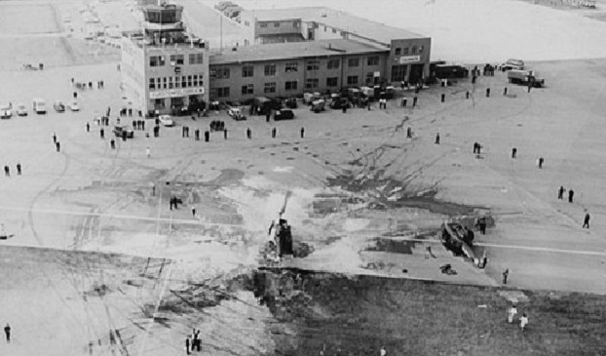
"The Games must go on, and we must ... and we must continue our efforts to keep them clean, pure and honest.” Avery Brundage, IOC President

Slide 20
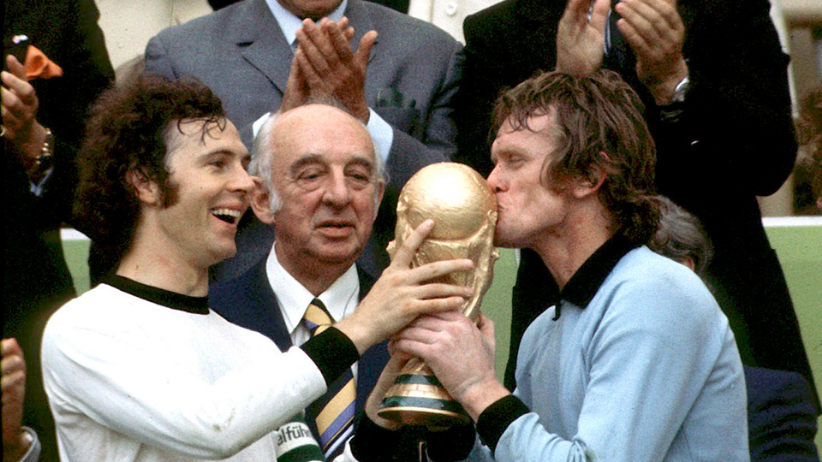
FIFA World Cup 1974
Notes:
Champion 1964, 1974, 1990, 2014

Slide 21
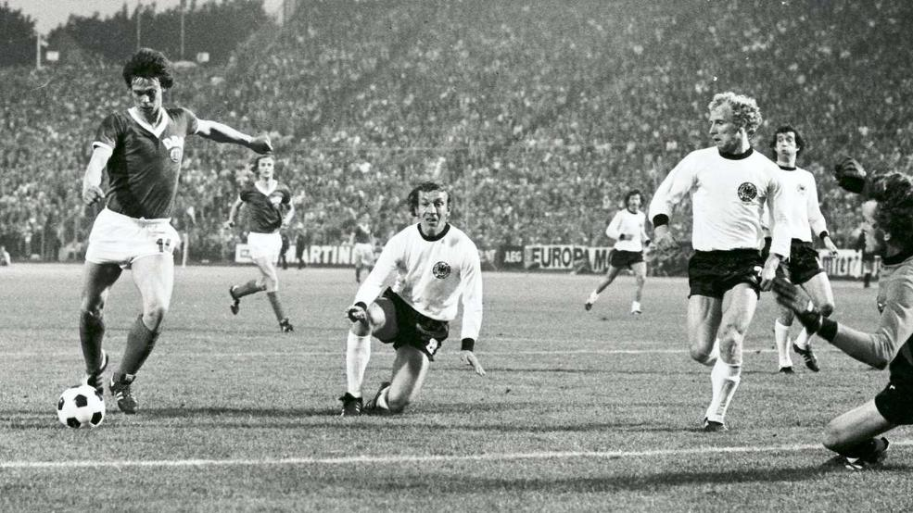

Slide 22
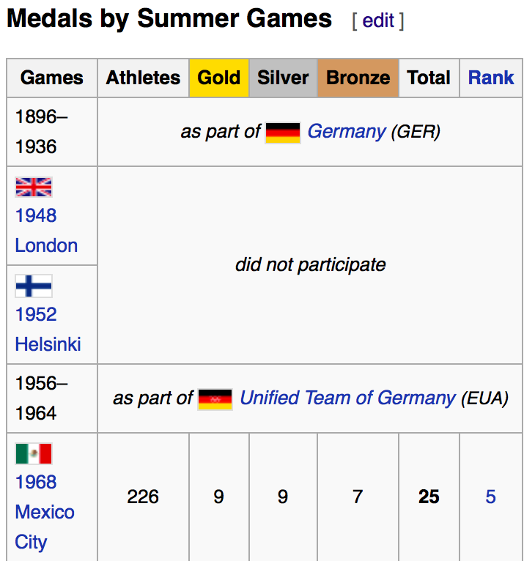
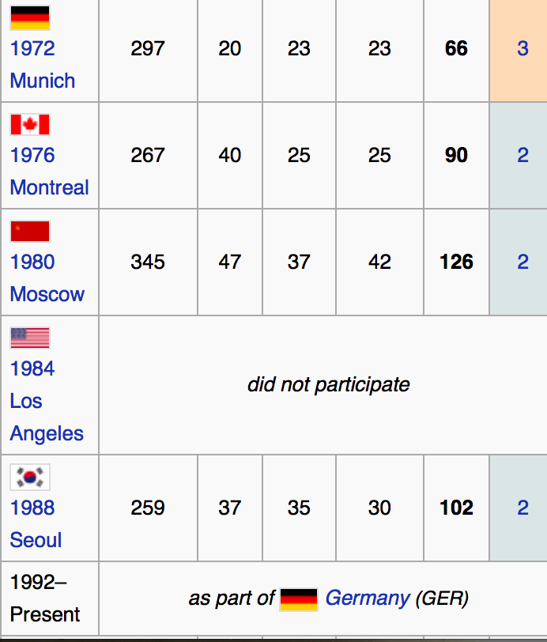
East German Medal Count

Slide 23
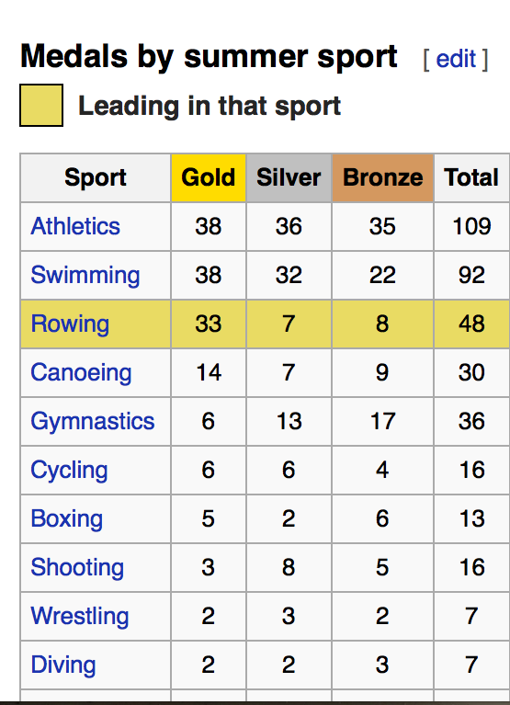

Slide 24
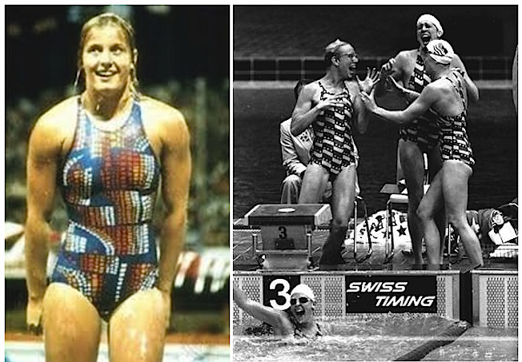

Slide 25
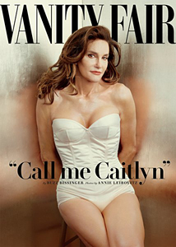

Slide 26
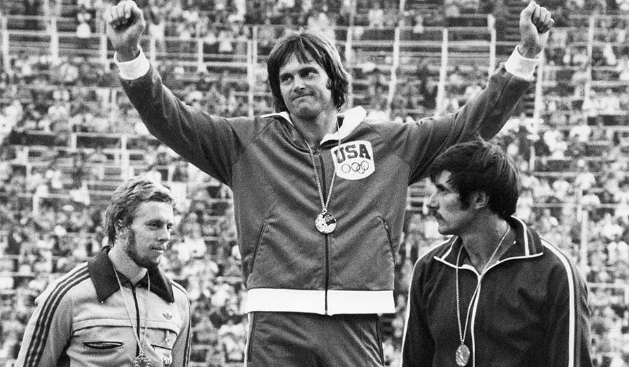

Slide 27
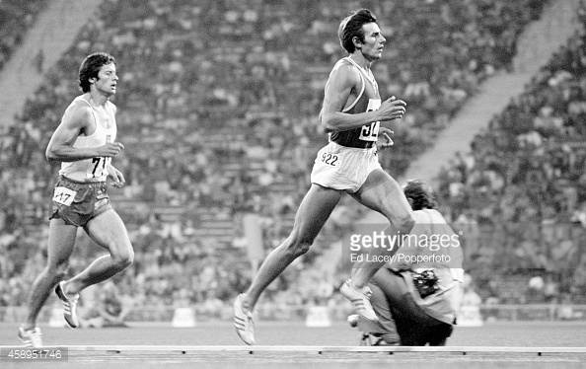
Nikolay Avilov, Gold medalist 1972

Slide 28
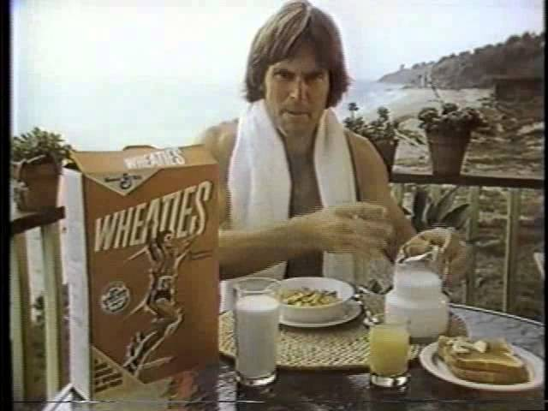

Slide 29
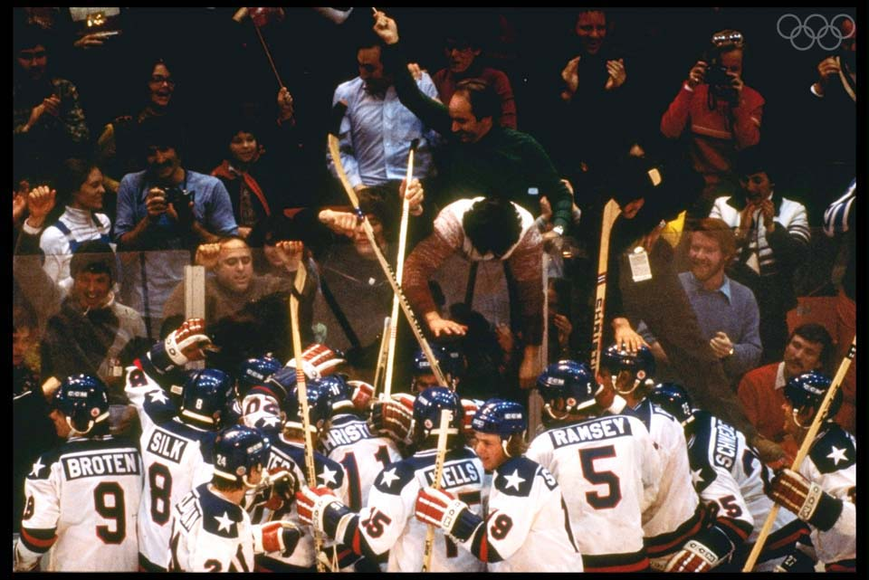
Lake Placid, 1980
Notes:
January Carter announcement

Slide 30
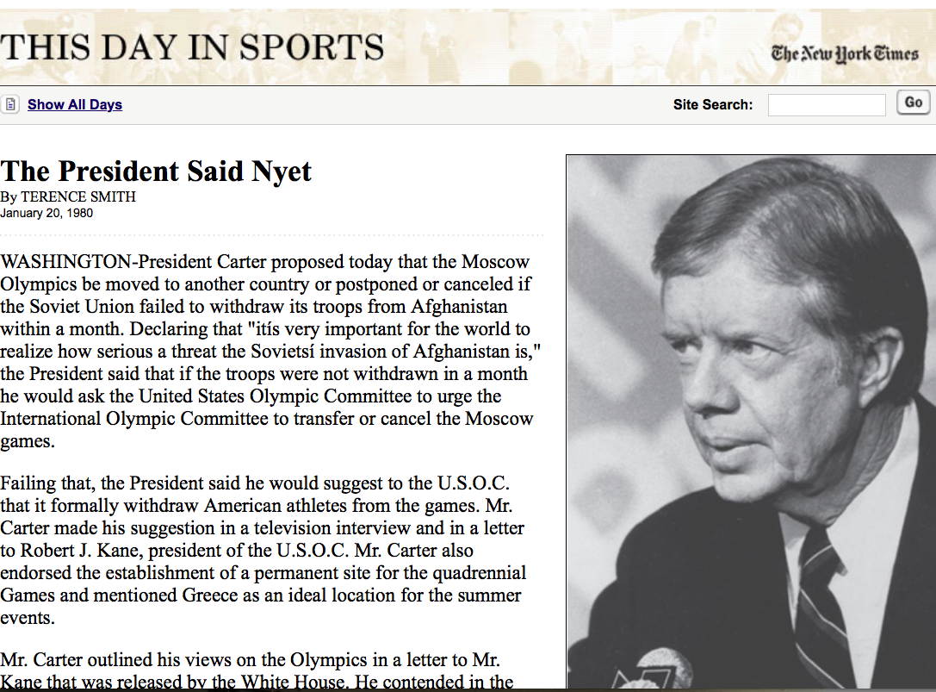

Slide 31
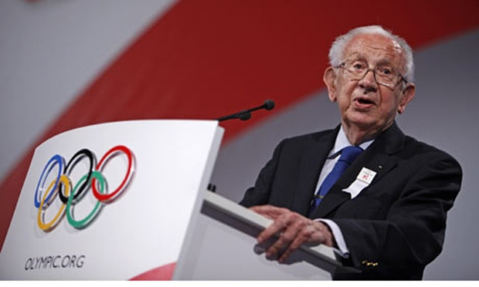
Leadership change
Juan Antonio Samaranch, IOC President 1980-2001
Notes:
Four year period, official sponsor of the games, for $50 million

Slide 32
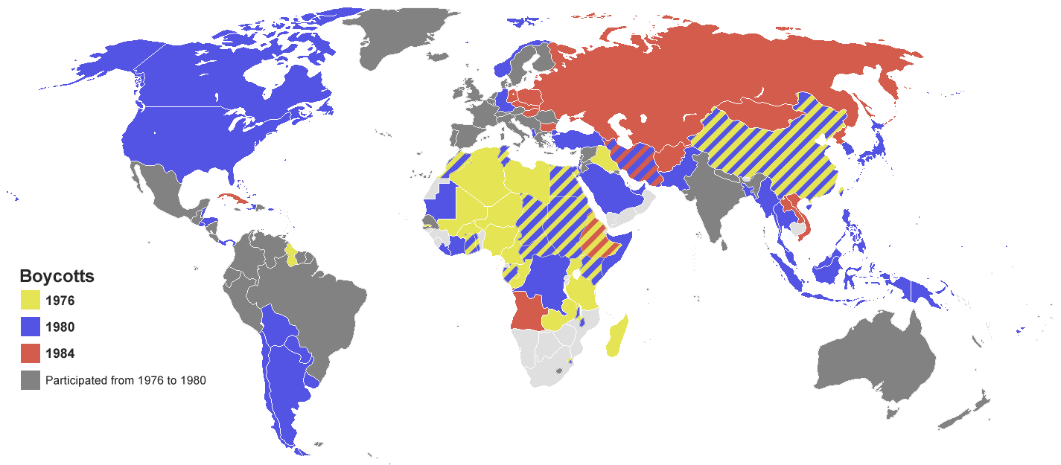
Notes:
Boycott L.A.: Evil Empire March 1983 – East Germany, Soviet Union

Slide 33
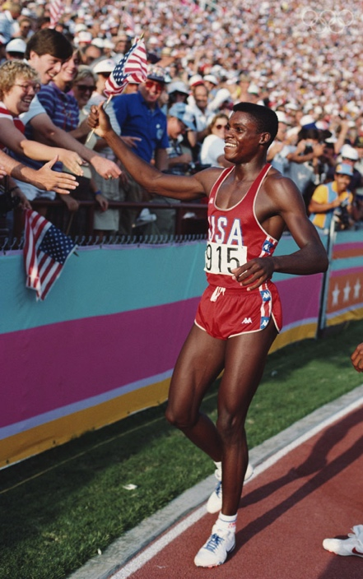
Los Angeles, 1984
Notes:
Unlike Montreal and Moscow – did not run into debt, because it used existing sports facilities
100 m, 200m, Long Jump Gold and 4x100 m relay
LA Games made more than $100 million from sponsorship
Amateur status given up in 1986

Slide 34
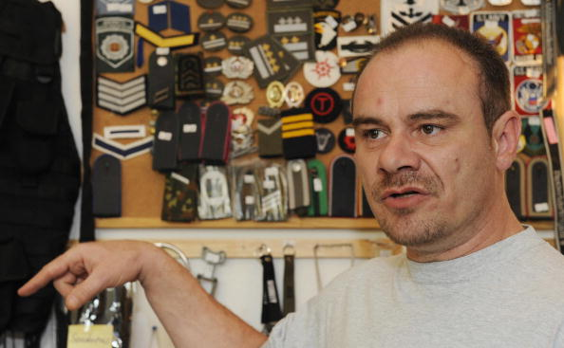
Andreas Krieger (GDR)

Slide 35
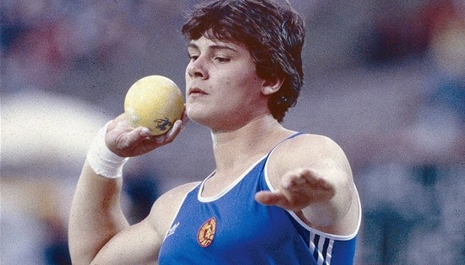
Heidi Krieger

Slide 36
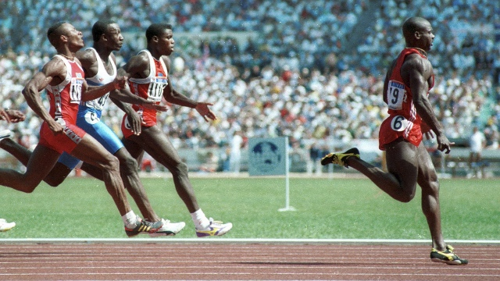
Seoul 1988
Notes:
Dubin inquiry – Canadian government, 1989 – banned and stripped of medals – six out of the 8 100 meter finalists at some point in their careers tested positive or were implicated in drug scandals – Stanozol – used steroids since 1981

Slide 37
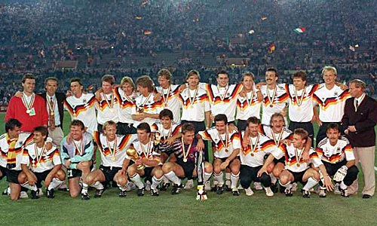
Soccer World Cup 1990

Slide 38
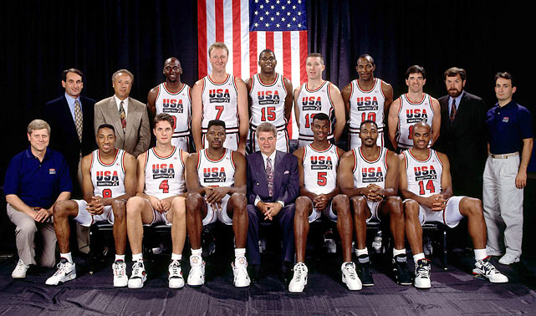
Barcelona, 1992

Slide 39
Thank you

